Slide 1
Acquire information from fly reference transcriptome GTF file
Jun Yin
05/01/18

Slide 2
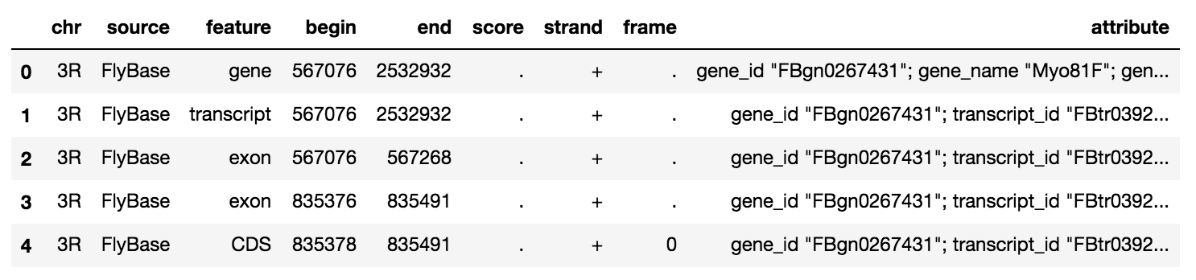
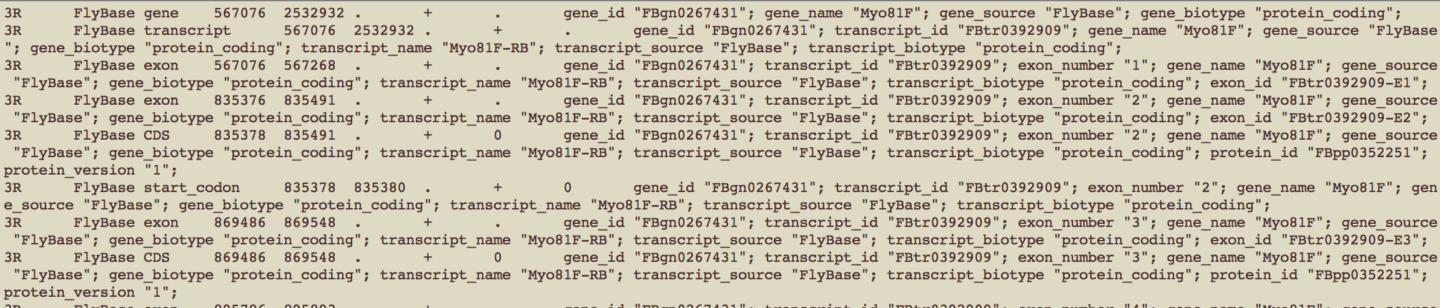
GTF file: tab-delimited text format
Reference transcriptome file is usually stored as GTF or GFF file
GTF/GFF file could reach to several Gb. Directly read it will use all of memory.

Slide 3
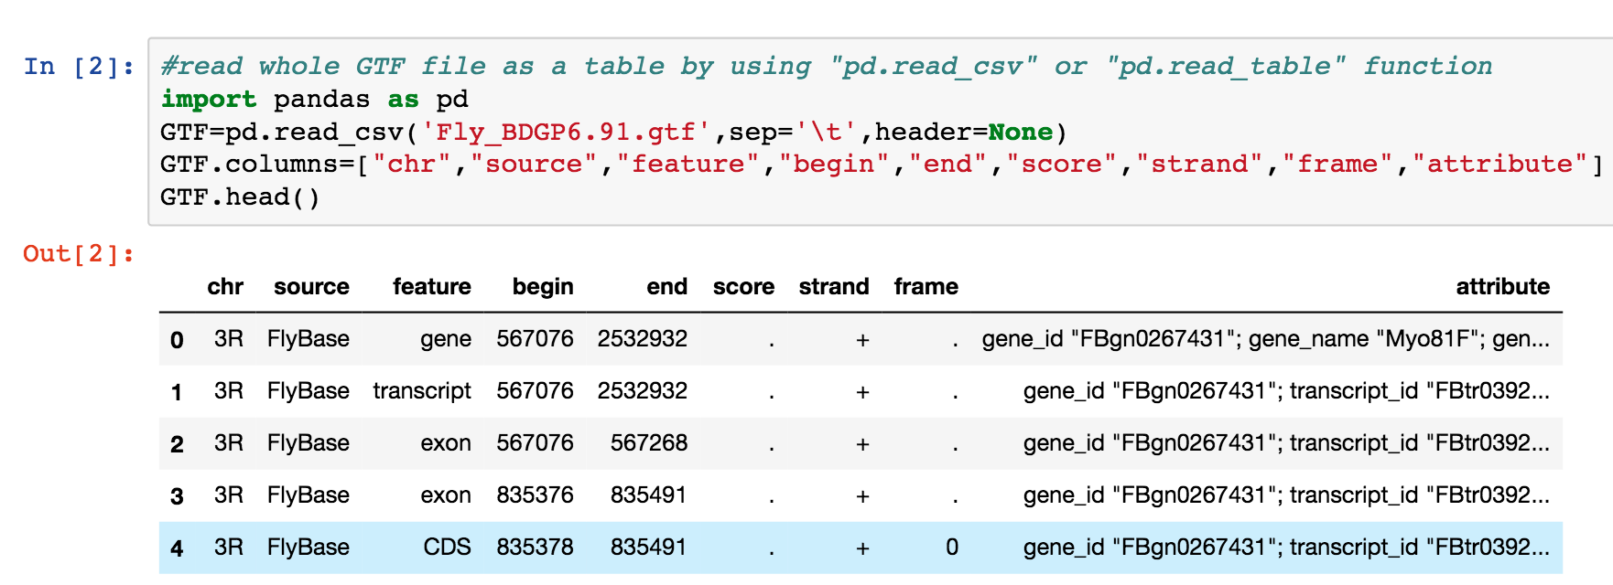
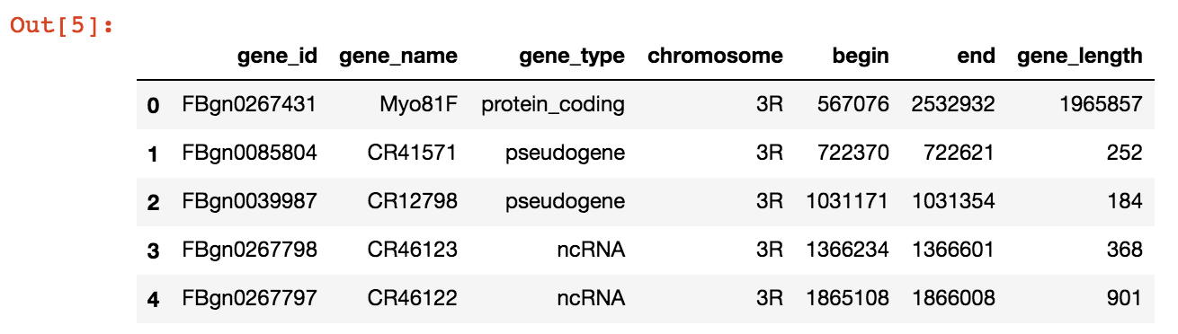
Desired output file
Input file
4
5
6
1
2
3
GTF
“Protein coding”
Output file

Slide 4
Workflow
GTF file format
Pandas/unix
Check chromosomes, feature information in GTF file with Pandas
Pandas/unix
Write python script to extract useful information from GTF file, output as a csv file:
1) gene_id, 2) gene_name, 3) gene_type, 4) chr, 5) begin, 6)end, 7) gene_length
1) Import csv
2) Open file and close file
3) For loop and if
4) Strip and split variable
5) csv.reader , delimiter and next
6) write csv
Plot with pandas and matplotlib.pyplot
gene numbers in each chromosome
Gene numbers in each RNA type
Gene length frequency
Pandas
Pyplot

Slide 5
Use pandas to read whole GTF file

Slide 6
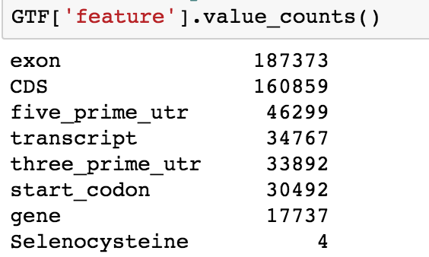
How many features in GTF file

Slide 7
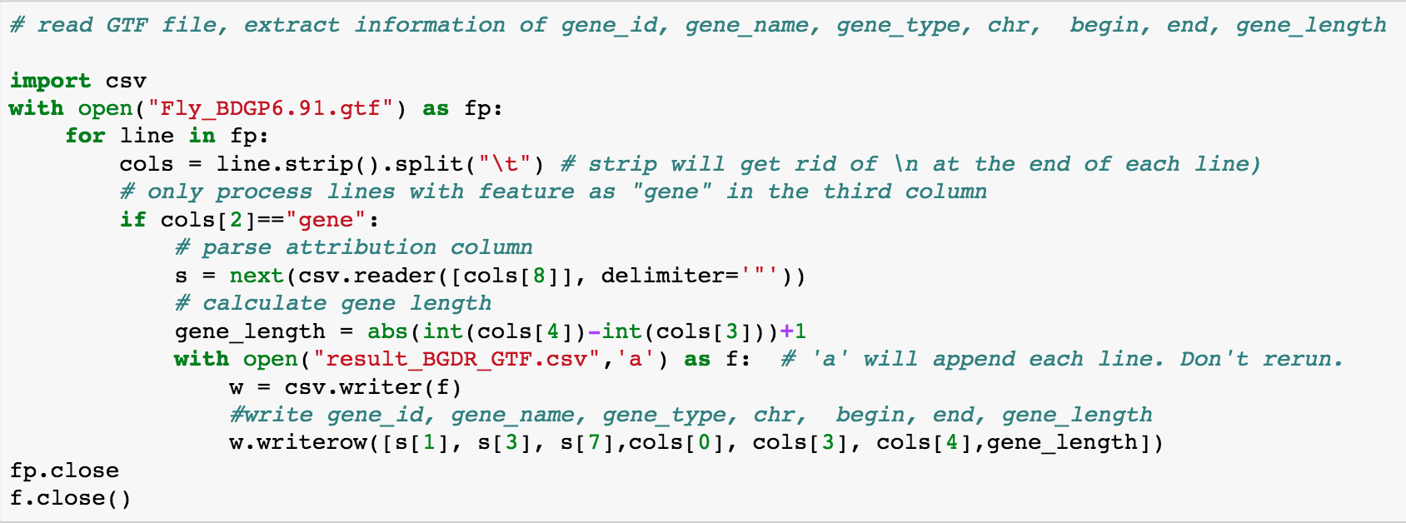
Python script to extract desired information
4
5
6
1
2
3
“Protein coding”

Slide 8
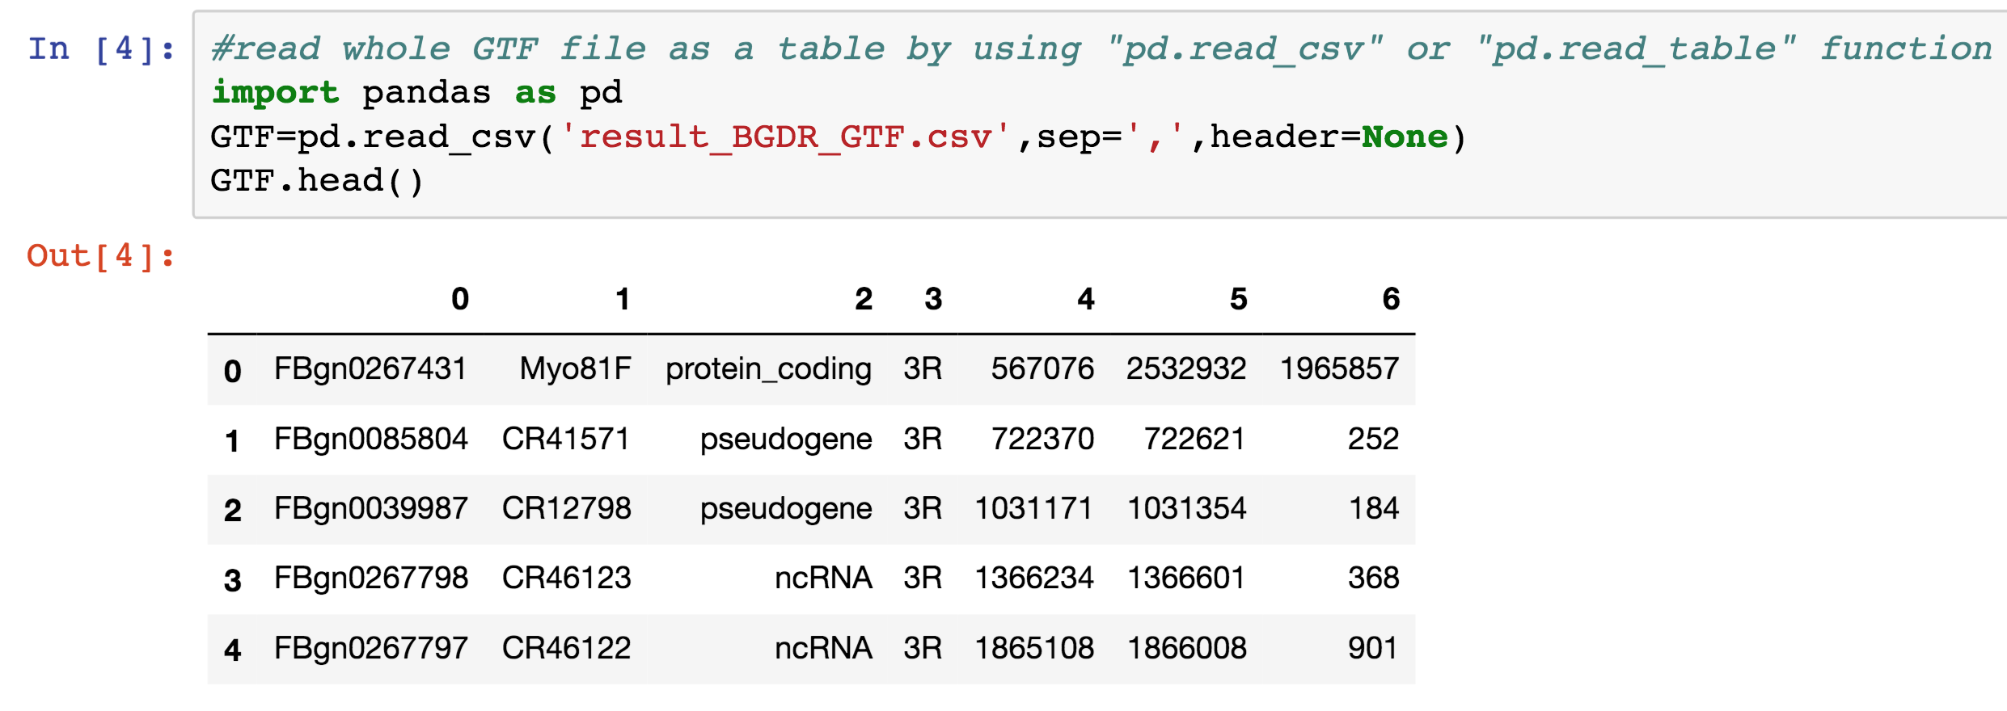
Work csv file with data frame in pandas

Slide 9
The csv file

Slide 10
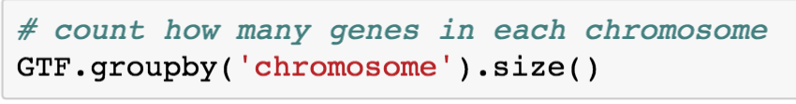
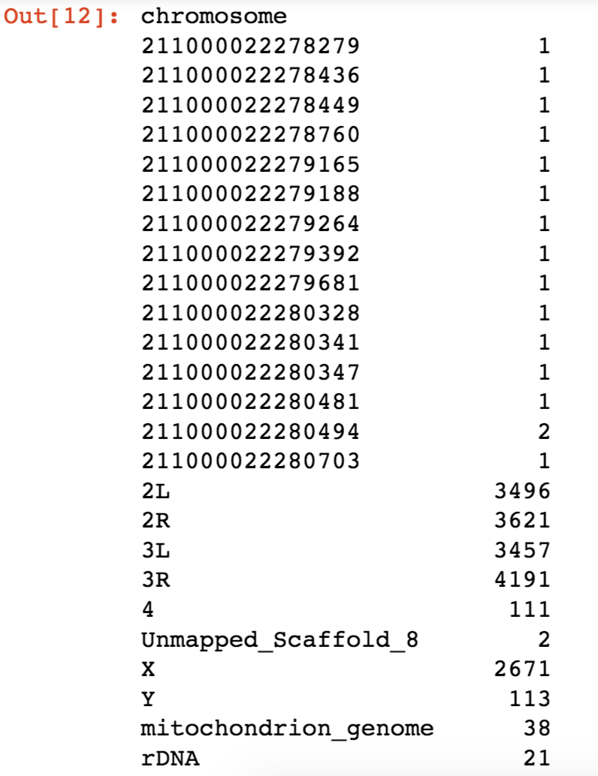
Count how many genes in each chromosome

Slide 11
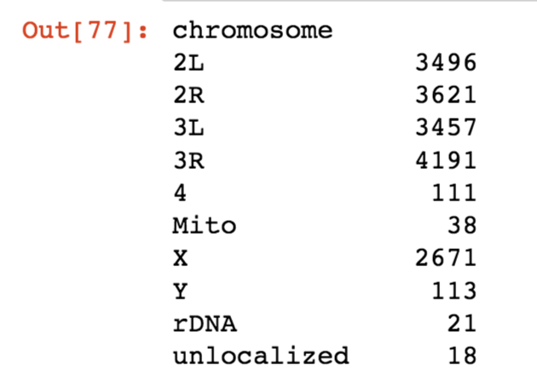
Change all numerical chromosome to unlocalized chromosome

Slide 12
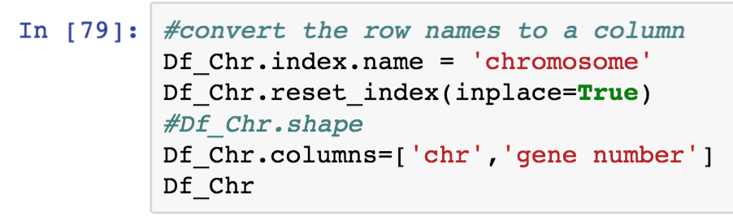
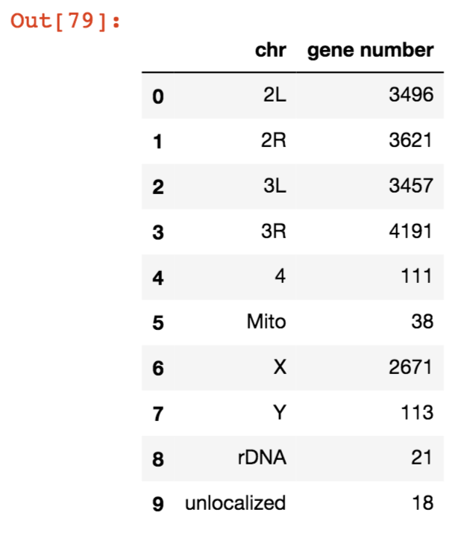
Convert row names to a new column

Slide 13
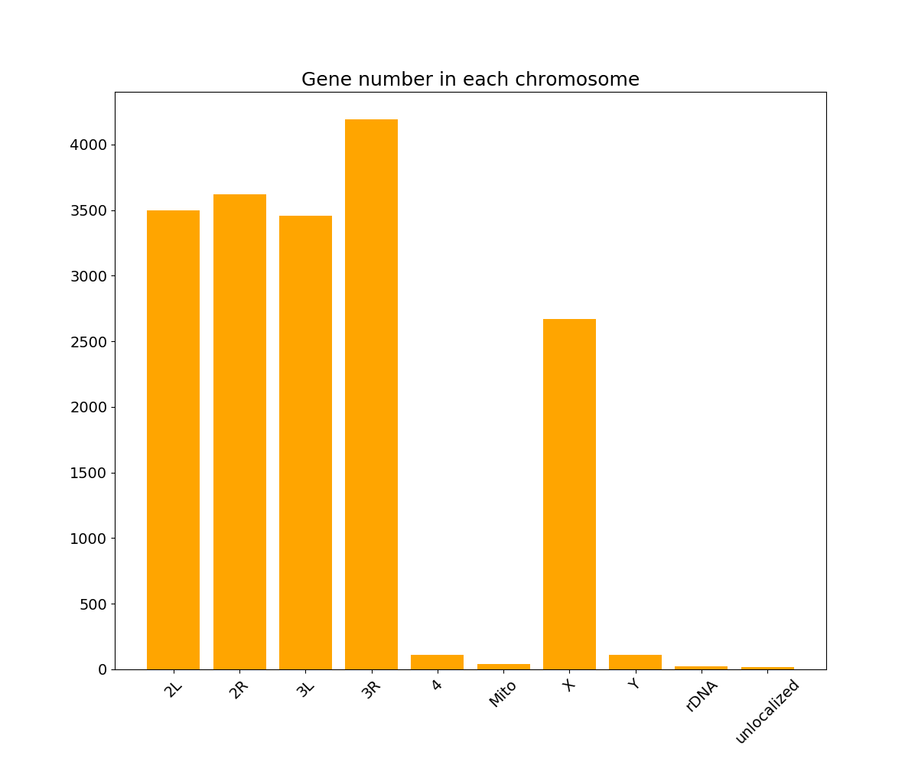
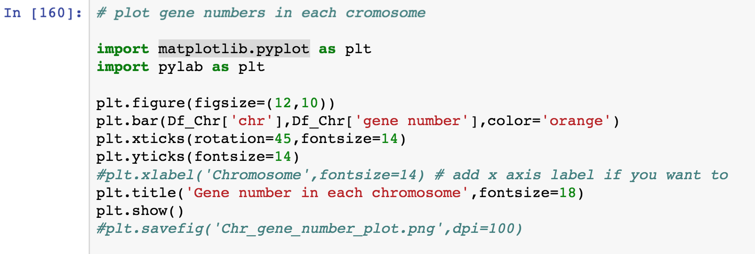
Plot gene numbers as plt with matplotlib.pyplot

Slide 14
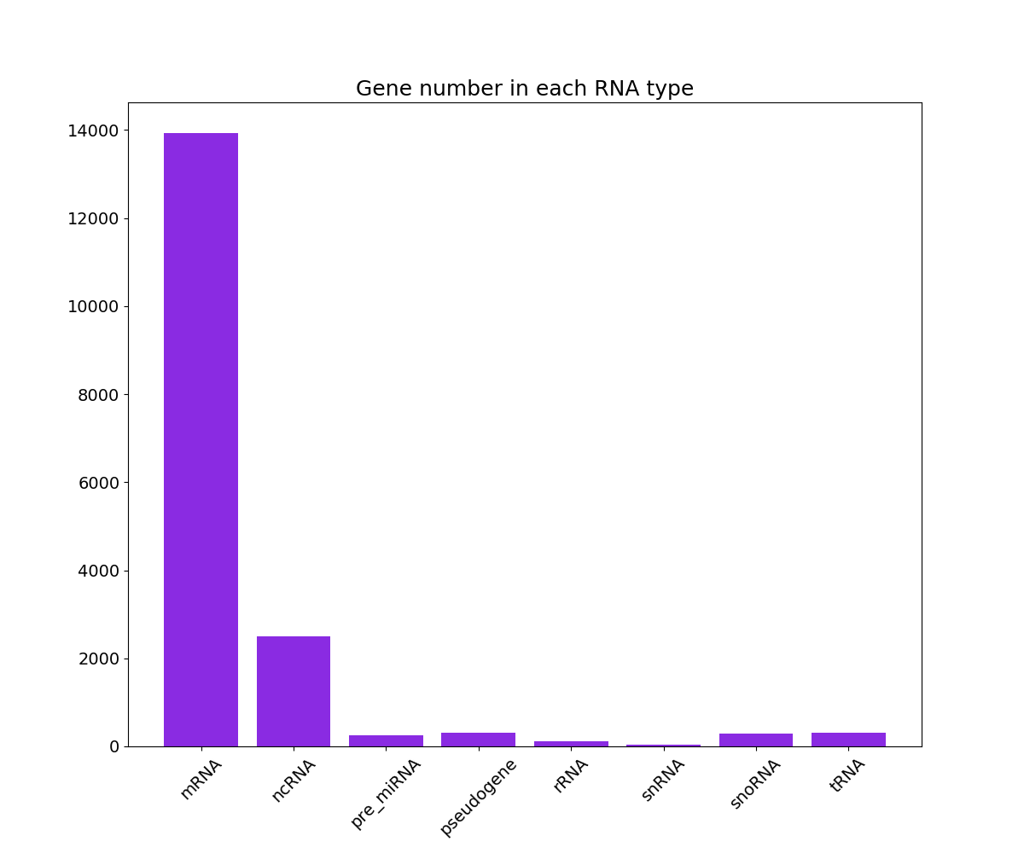
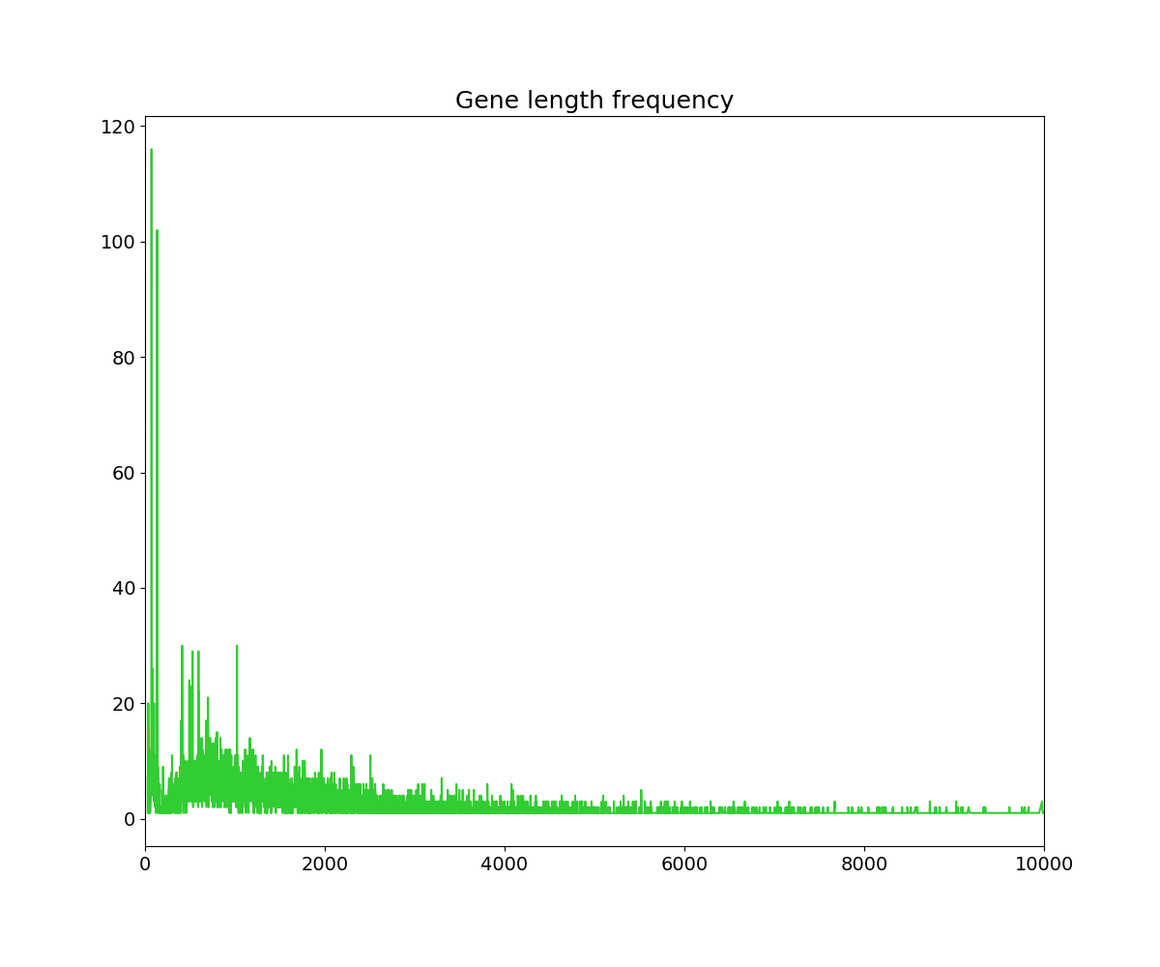
Plot gene number in each RNA type and gene length frequency

Slide 15
Thank you !

